Slide 1
Path Planning and Obstacle Avoidance for Under-actuated System via Heat Flow Method
Shenyu Liu
Coordinated Science Laboratory
University of Illinois at Urbana-Champaign
sliu@Illinois.edu

Slide 2
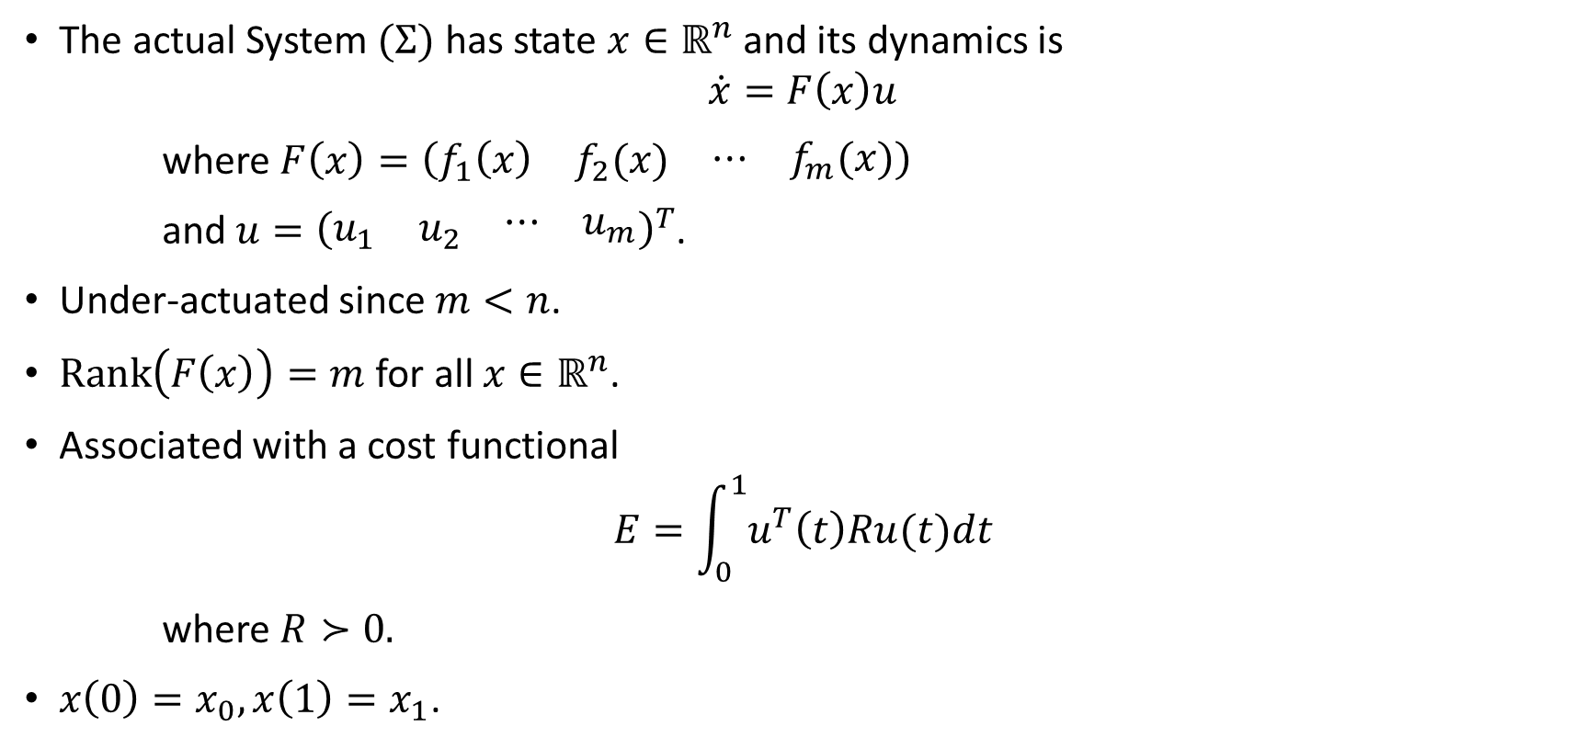
System & Cost Definition
The actual System $(Σ)$ has state $x∈ℝ^{n}$ and its dynamics is
$$\dot{x}=F\left(x\right)u$$
where $F\left(x\right)=\left(\begin{matrix}f_{1}\left(x\right) & f_{2}(x) & \begin{matrix}⋯ & f_{m}(x)\end{matrix}\end{matrix}\right)$
and $u={\left(\begin{matrix}u_{1} & u_{2} & \begin{matrix}⋯ & u_{m}\end{matrix}\end{matrix}\right)}^{T}$.
Under-actuated since $m<n$.
$Rank\left(F\left(x\right)\right)=m$ for all $x∈ℝ^{n}$.
Associated with a cost functional
$$E=\int_{0}^{1}{u^{T}\left(t\right)Ru(t)dt}$$
where $R≻0.$
$x\left(0\right)=x_{0},x\left(1\right)=x_{1}$.

Slide 3
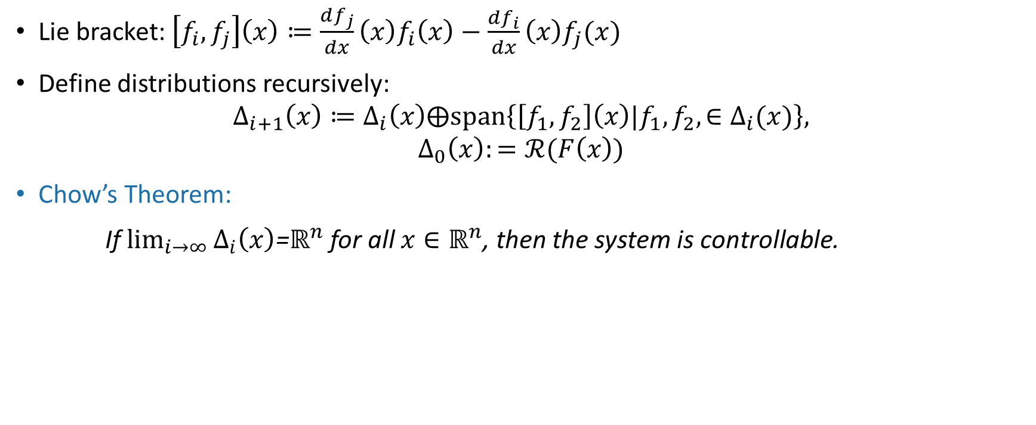
Controllability
Lie bracket: $\left[f_{i},f_{j}\right]\left(x\right)≔\frac{df_{j}}{dx}\left(x\right)f_{i}\left(x\right)−\frac{df_{i}}{dx}\left(x\right)f_{j}(x)$
Define distributions recursively:
$$Δ_{i+1}\left(x\right)≔Δ_{i}\left(x\right)⨁span\left\{\left[f_{1},f_{2}\right]\left(x\right)|f_{1},f_{2},∈Δ_{i}(x)\right\},$$
$$Δ_{0}\left(x\right):=ℛ(F\left(x\right))$$
Chow’s Theorem:
If $\lim_{i→∞}{Δ_{i}\left(x\right)}$=$ℝ^{n}$ for all $x∈ℝ^{n}$, then the system is controllable.

Slide 4
Remark
Various ways of finding optimal control: maximum principle, HJB equation, etc.
Good for simple systems; solutions are hard to find for systems of large dimensions and other general complex systems.
Can be weak solution; i.e., not continuously differentiable.
Boundary value problem; difficult to solve and solution may not be unique.

Slide 5
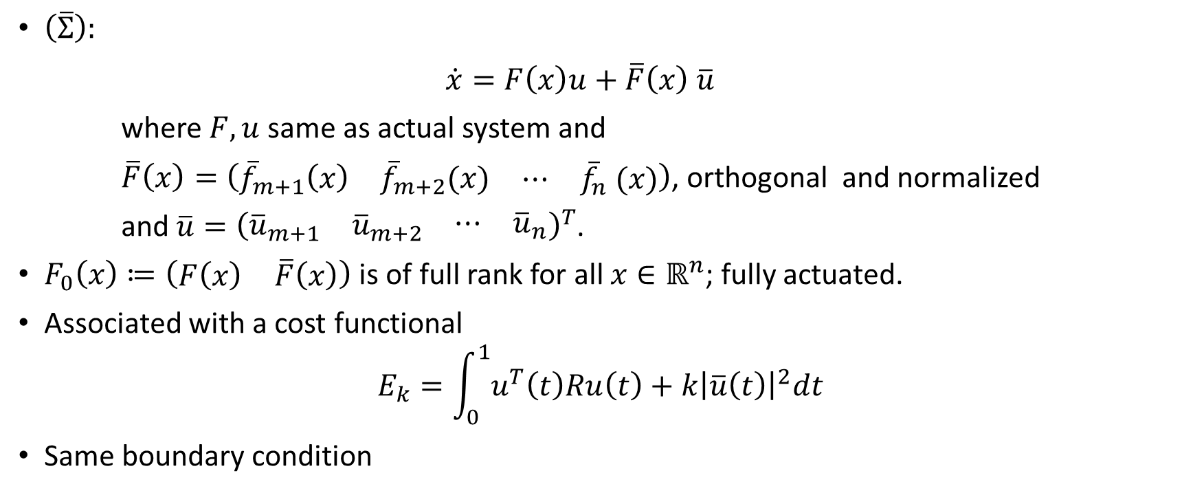
Augmented system
$\left(\overline{Σ}\right):$
$\dot{x}=F\left(x\right)u+\overline{F}\left(x\right) \overline{u}$
where $F,u$ same as actual system and
$\overline{F}\left(x\right)=\left(\begin{matrix}{\overline{f}}_{m+1}\left(x\right) & {\overline{f}}_{m+2}(x) & \begin{matrix}⋯ & {\overline{f}}_{n} (x)\end{matrix}\end{matrix}\right)$, orthogonal and normalized
and $\overline{u}={\left(\begin{matrix}{\overline{u}}_{m+1} & {\overline{u}}_{m+2} & \begin{matrix}⋯ & {\overline{u}}_{n}\end{matrix}\end{matrix}\right)}^{T}$.
$F_{0}\left(x\right)≔\left(\begin{matrix}F\left(x\right) & \overline{F}\left(x\right)\end{matrix}\right)$ is of full rank for all $x∈ℝ^{n}$; fully actuated.
Associated with a cost functional
$$E_{k}=\int_{0}^{1}{u^{T}\left(t\right)Ru\left(t\right)+k{\left|\overline{u}\left(t\right)\right|}^{2}dt}$$
Same boundary condition

Slide 6
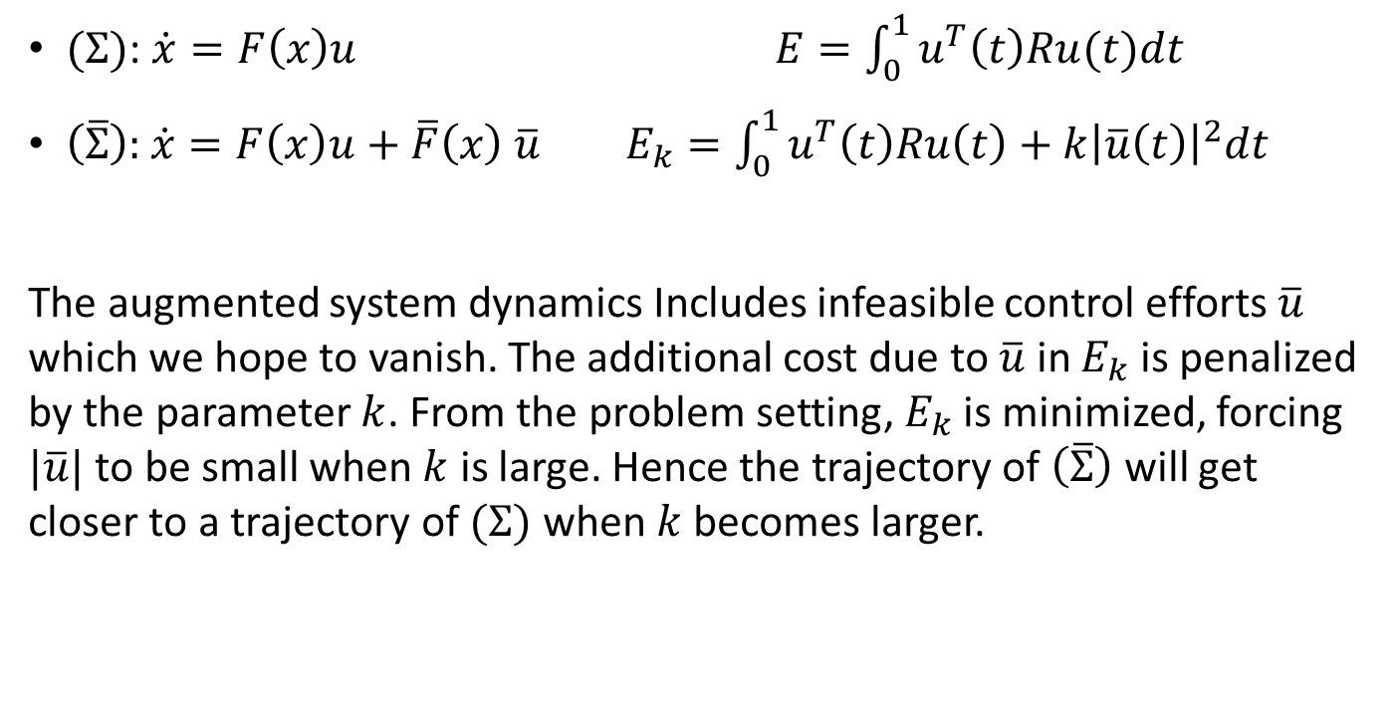
Intuition
$(Σ)$: $\dot{x}=F\left(x\right)u$ $E=\int_{0}^{1}{u^{T}\left(t\right)Ru(t)dt}$
$\left(\overline{Σ}\right):$ $\dot{x}=F\left(x\right)u+\overline{F}\left(x\right) \overline{u}$ $E_{k}=\int_{0}^{1}{u^{T}\left(t\right)Ru\left(t\right)+k{\left|\overline{u}\left(t\right)\right|}^{2}dt}$
The augmented system dynamics Includes infeasible control efforts $\overline{u}$ which we hope to vanish. The additional cost due to $\overline{u}$ in $E_{k}$ is penalized by the parameter $k$. From the problem setting, $E_{k}$ is minimized, forcing $|\overline{u}|$ to be small when $k$ is large. Hence the trajectory of $\left(\overline{Σ}\right)$ will get closer to a trajectory of $(Σ)$ when $k$ becomes larger.

Slide 7
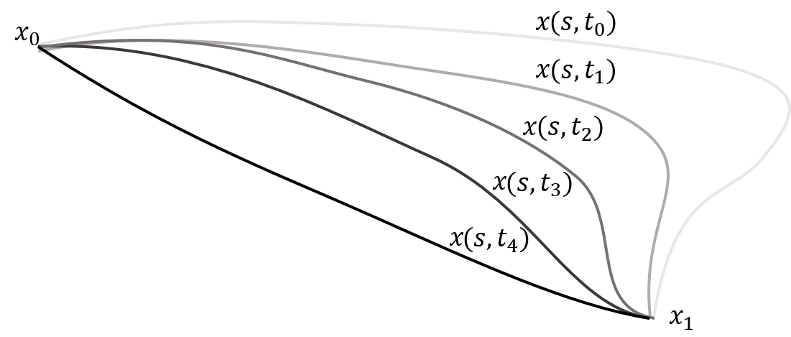
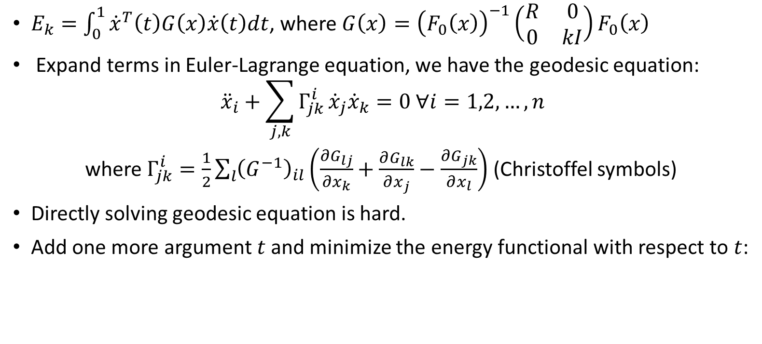
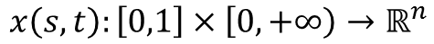
Geodesic equation
$E_{k}=\int_{0}^{1}{{\dot{x}}^{T}\left(t\right)G\left(x\right)\dot{x}\left(t\right)dt}$, where $G\left(x\right)={\left(F_{0}\left(x\right)\right)}^{−1}\left(\begin{matrix}R & 0 \\ 0 & kI\end{matrix}\right)F_{0}\left(x\right)$
Expand terms in Euler-Lagrange equation, we have the geodesic equation:
$${\ddot{x}}_{i}+\sum_{j,k}{Γ_{jk}^{i}}{\dot{x}}_{j}{\dot{x}}_{k}=0 ∀i=1,2,…,n$$
where $Γ_{jk}^{i}=\frac{1}{2}\sum_{l}{{\left(G^{−1}\right)}_{il}\left(\frac{∂G_{lj}}{∂x_{k}}+\frac{∂G_{lk}}{∂x_{j}}−\frac{∂G_{jk}}{∂x_{l}}\right)}$ (Christoffel symbols)
Directly solving geodesic equation is hard.
Add one more argument $t$ and minimize the energy functional with respect to $t$:
$$x\left(s,t\right):\left[0,1\right]×\left[0,+∞\right)→ℝ^{n}$$

Slide 8
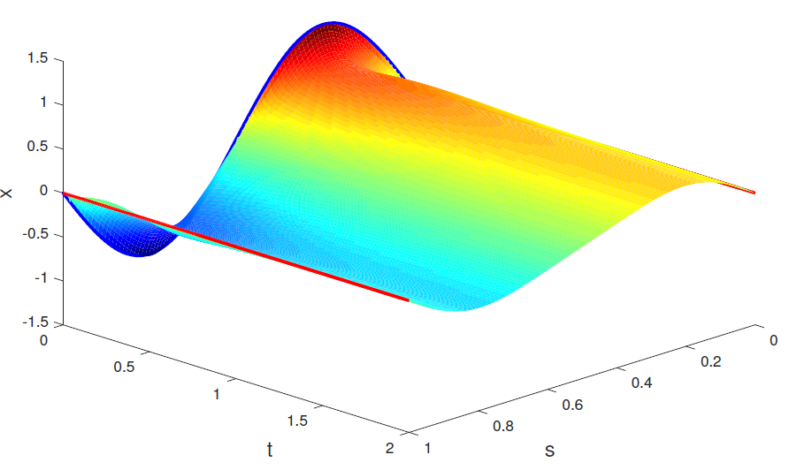
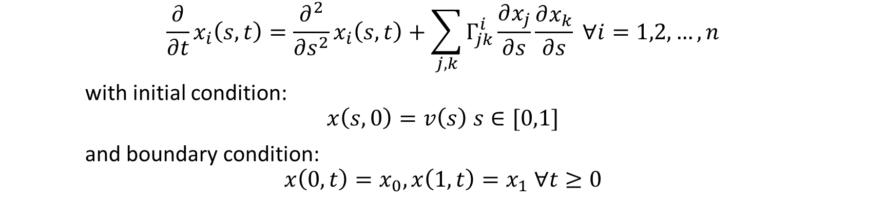
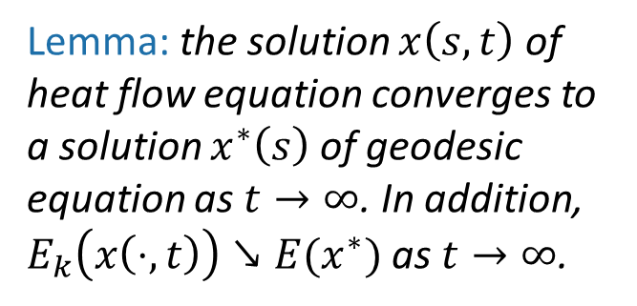
Heat flow equation
$$\frac{∂}{∂t}x_{i}\left(s,t\right)=\frac{∂^{2}}{∂s^{2}}x_{i}\left(s,t\right)+\sum_{j,k}{Γ_{jk}^{i}\frac{∂x_{j}}{∂s}\frac{∂x_{k}}{∂s}} ∀i=1,2,…,n$$
with initial condition:
$$x\left(s,0\right)=v\left(s\right) s∈[0,1]$$
and boundary condition:
$$x\left(0,t\right)=x_{0}, x\left(1,t\right)=x_{1} ∀t≥0$$
Lemma: the solution $x\left(s,t\right)$ of heat flow equation converges to a solution $x^{∗}\left(s\right)$ of geodesic equation as $t→∞$. In addition, $E_{k}\left(x\left(⋅,t\right)\right)↘E(x^{∗})$ as $t→∞$.

Slide 9
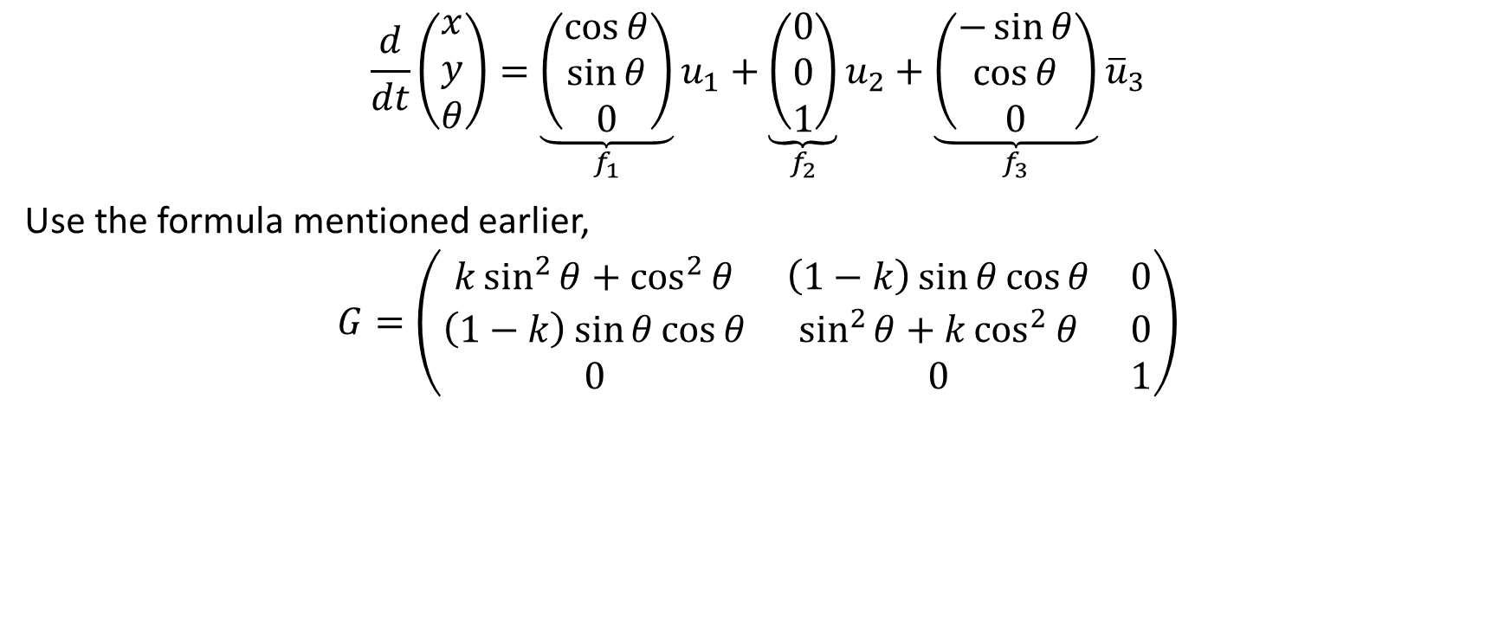
Example: unicycle
$$\frac{d}{dt}\left(\begin{matrix}x \\ y \\ θ\end{matrix}\right)=\underset{f_{1}}{\underbrace{\left(\begin{matrix}\cos{θ} \\ \sin{θ} \\ 0\end{matrix}\right)}}u_{1}+{\underset{f_{2}}{\underbrace{\left(\begin{matrix}0 \\ 0 \\ 1\end{matrix}\right)}}u}_{2}+{\underset{f_{3}}{\underbrace{\left(\begin{matrix}−\sin{θ} \\ \cos{θ} \\ 0\end{matrix}\right)}}\overline{u}}_{3}$$
Use the formula mentioned earlier,
$$G=\left(\begin{matrix}k\sin^{2}{θ+\cos^{2}{θ}} & \left(1−k\right)\sin{θ}\cos{θ} & 0 \\ \left(1−k\right)\sin{θ}\cos{θ} & \sin^{2}{θ+k\cos^{2}{θ}} & 0 \\ 0 & 0 & 1\end{matrix}\right)$$

Slide 10
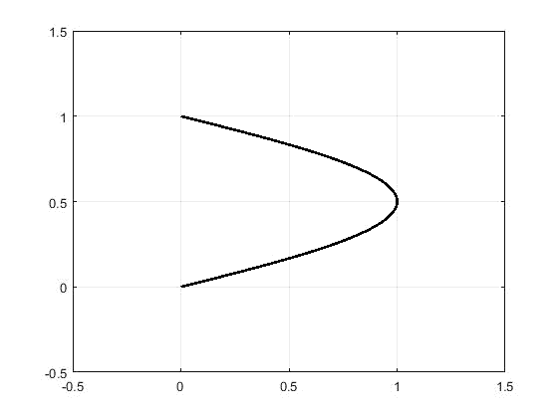
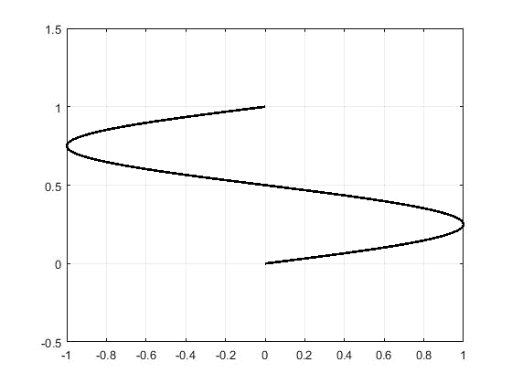
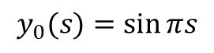
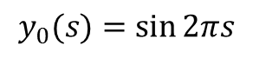
Unicycle Parallel Parking
$$y_{0}(s)=\sin{πs}$$
$$y_{0}(s)=\sin{2πs}$$

Slide 11
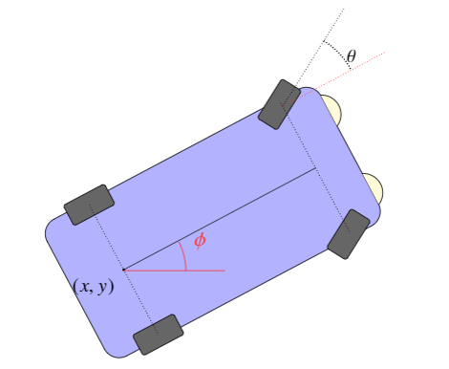
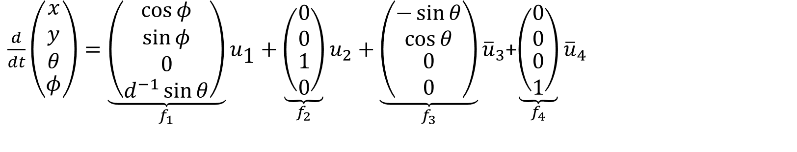
Example: boxcar
$\frac{d}{dt}\left(\begin{aligned}\begin{matrix}x \\ y \\ θ\end{matrix} \\ φ\end{aligned}\right)=\underset{f_{1}}{\underbrace{\left(\begin{matrix}\cos{φ} \\ \sin{φ} \\ \begin{aligned}0 \\ d^{−1}\sin{θ}\end{aligned}\end{matrix}\right)}}u_{\text{1}}+{\underset{f_{2}}{\underbrace{\left(\begin{matrix}0 \\ 0 \\ \begin{aligned}1 \\ 0\end{aligned}\end{matrix}\right)}}u}_{2}+{\underset{f_{3}}{\underbrace{\left(\begin{matrix}−\sin{θ} \\ \cos{θ} \\ \begin{aligned}0 \\ 0\end{aligned}\end{matrix}\right)}}\overline{u}}_{3}$+${\underset{f_{4}}{\underbrace{\left(\begin{matrix}0 \\ 0 \\ \begin{aligned}0 \\ 1\end{aligned}\end{matrix}\right)}}\overline{u}}_{4}$

Slide 12
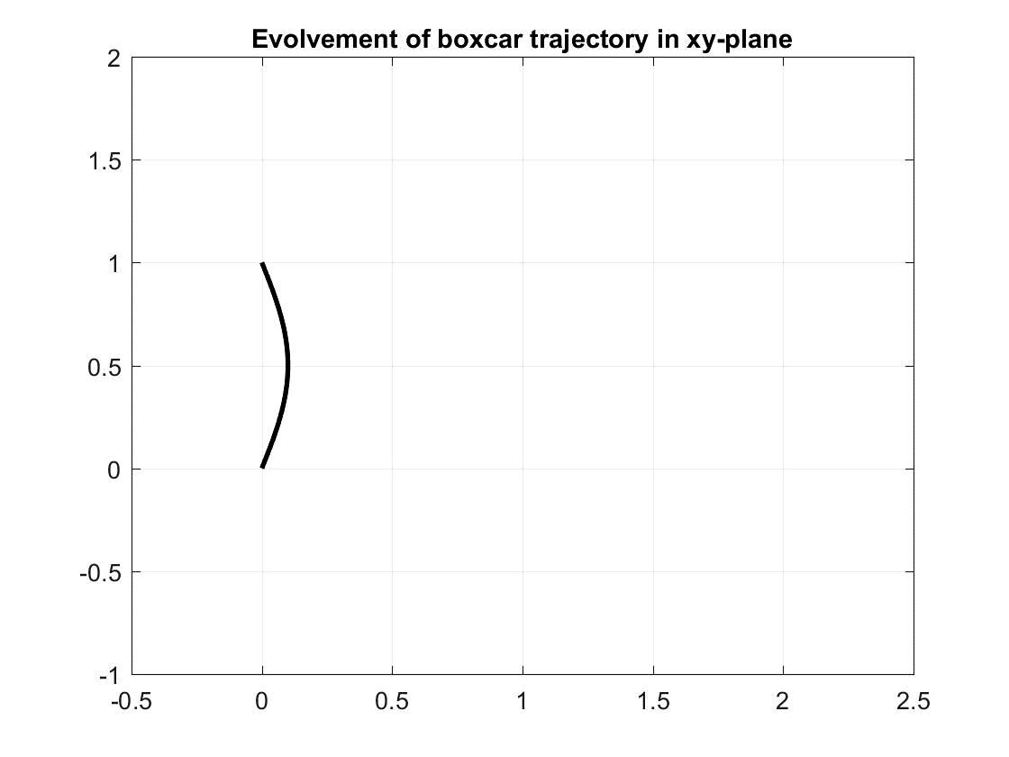
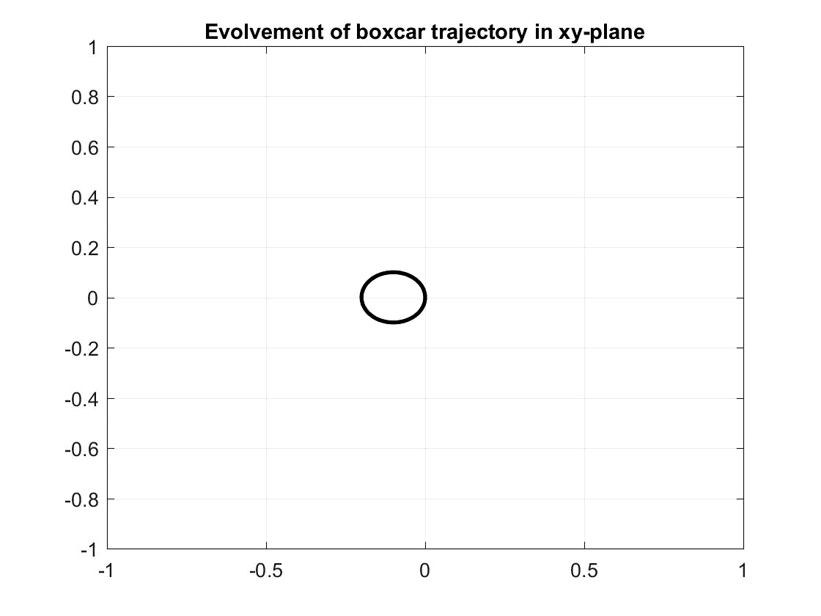
Boxcar
Parallel Parking
180⁰ turning

Slide 13
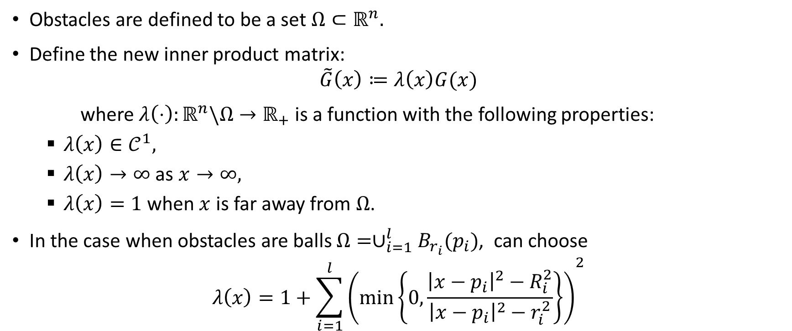
Obstacle Avoidance
Obstacles are defined to be a set $Ω⊂ℝ^{n}.$
Define the new inner product matrix:
$$\tilde{G}\left(x\right)≔λ\left(x\right)G(x)$$
where $λ\left(⋅\right):ℝ^{n}\backslash Ω→ℝ_{+}$ is a function with the following properties:
$λ\left(x\right)∈𝒞^{1},$
$λ\left(x\right)→∞$ as $x→∞,$
$λ\left(x\right)=1$ when $x$ is far away from $Ω$.
In the case when obstacles are balls $Ω=∪_{i=1}^{l}B_{r_{i}}(p_{i})$, can choose
$$λ\left(x\right)=1+{\sum_{i=1}^{l}{\left(\min\left\{0,\frac{{\left|x−p_{i}\right|}^{2}−R_{i}^{2}}{{\left|x−p_{i}\right|}^{2}−r_{i}^{2}}\right\}\right)}}^{2}$$

Slide 14
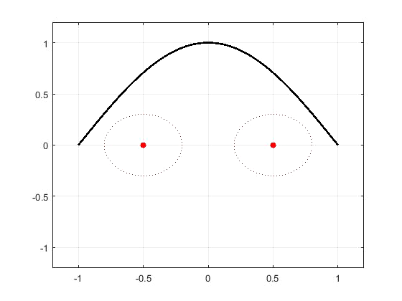
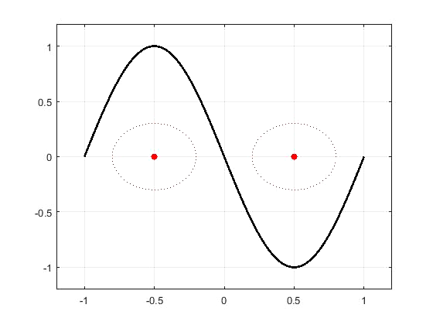
Obstacle Avoidance
Bypass from same side of obstacles
Bypass from opposite sides of obstacles

Slide 15
Advantage
It is observed that an advantage of path planning via heat flow equation is that by customizing initial curve, we are able to configure how these obstacles are by-passed. On the contrary, directly solving the geodesic equation will not give the customized shortest path.

Slide 16
Conclusion
Proposed a way to find optimal control for under-actuated nonlinear affine system by applying heat flow method to an augmented system with a penalty in the infeasible control direction.
Examining the convergence of trajectory of augmented system to that of actual system with respect to the penalty gain.
Studied the application of our heat flow method in path planning with obstacle avoidance. Pointed out its advantage in path shape configuration.

Slide 17
Thank you!

